Slide 1
Is the outlook sunny for solar?
A time-series analysis of select us-based companies within the solar industry

Slide 2
Research Questions
Can we predict stock prices of companies pushing the solar industry forward with reasonable accuracy?
Based on what we learn, does investing in solar hold promise?

Slide 3
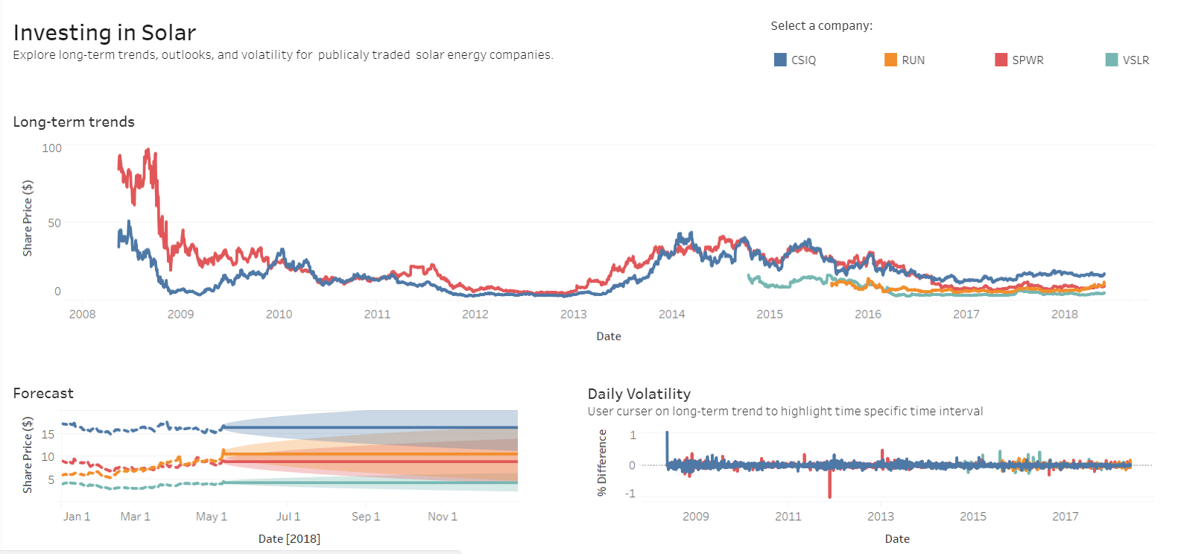
Product concept
Investment tool for people looking to invest in publicly traded companies working on renewable energy technology
Help investors easily find and analyze performance of relevant companies
Compare performance to competitors
Focus here is on solar, but could be scaled up to include filtering option by renewable energy type
Market research shows current social/environment driven investment platforms are either crowdfunding for startups (i.e. not publicly traded) or more focused on corporate social responsibility metrics
Tableau dashboard at end as concept demo

Slide 4


The data
Selected two companies traded on NASDAQ in the solar industry
Data from Nasdaq.com (10-yr historical)
Closing price
Sunrun, Inc. (RUN)
San Francisco, CA
Focused on residential solar
IPO August 2015
2.75 years of daily data (weekdays only) = 698
Sunpower (SPWR)
San Jose, CA
Solutions for residential, business, and solar energy power plants (solar farms)
IPO November 2005
10 years of daily data = 2513

Slide 5
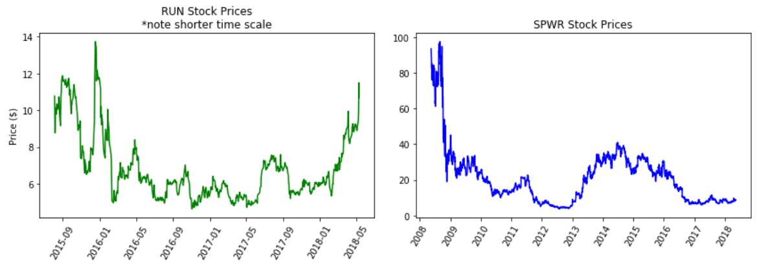
Time-series exploration
Politics?
On the rise?
Hit hard by recession
Politics?

Slide 6
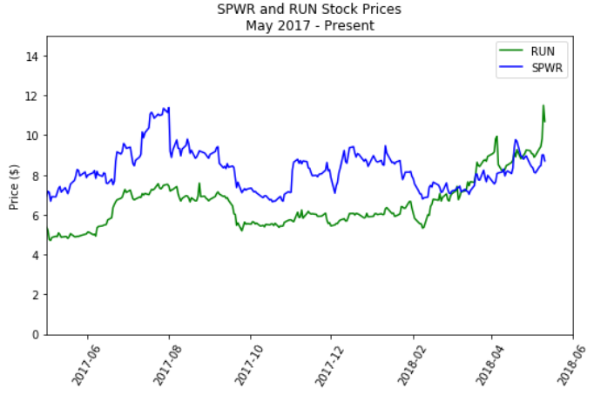
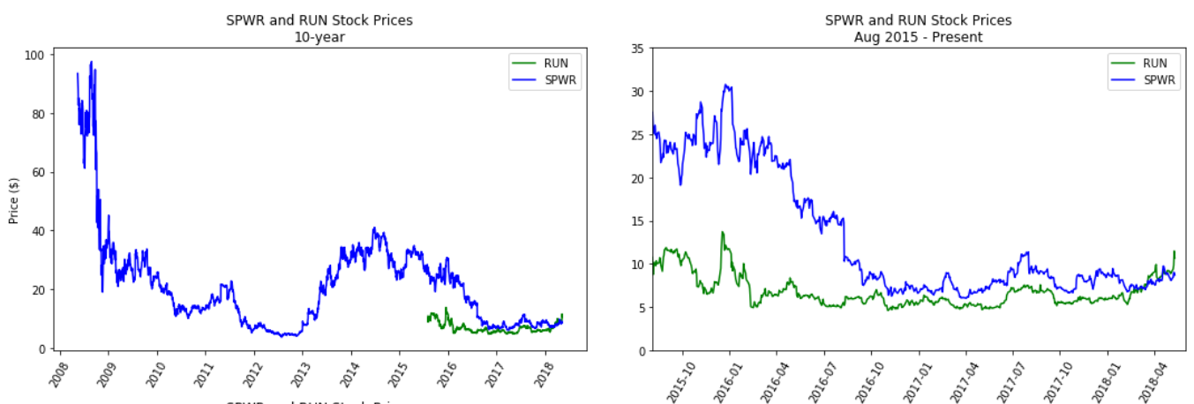

Time-series exploration

Slide 7
Time-series decomposition
Break time-series into systematic and non-systematic parts
Systematic - repeating structure/patterns that can be modeled
Trend
Seasonality (daily, weekly, actual seasons, etc.)
Non-systematic components – cannot be modeled
Error
Randomness

Slide 8
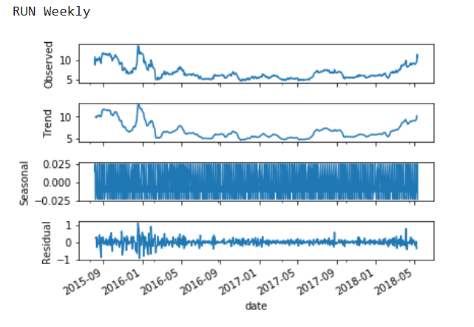
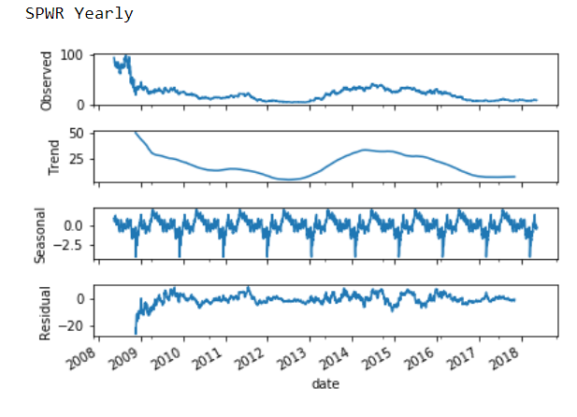
Time-series decomposition
No true structure (foreshadow)
Smoothed averages of daily values
Seasonality not an actual signal

Slide 9
modeling
Check for stationarity first
Mean and variance stability over time
If not stationary, make stationary by differencing or incorporate into model
Models tested:
ARIMA
Prophet (Facebook library)

Slide 10
ARIMA
AutoRegressive Integrated Moving Average
Extension of linear least squares regression
AR(p) – Lag order; number of lag terms to consider
I(d) – Degree of differencing to make stationary
MA(q) – Size of moving average window
ARIMA (p,d,q)

Slide 11
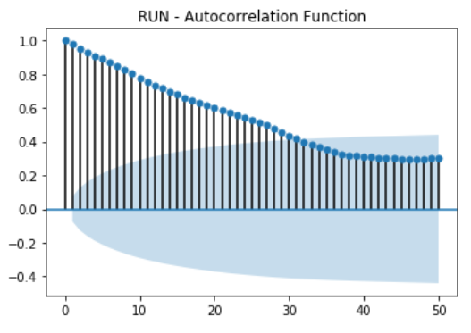
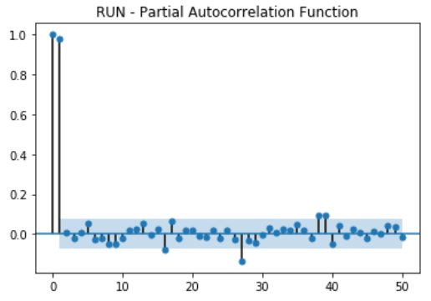
ARIMA – model parameters
ACF – Autoregressive correlation function (MA)
PACF – Partial autoregressive correlation function (AR)

Slide 12
Arima – model parameters
Used ACF/PACF plots to get ballpark range of p, d, q values
Grid search possible combinations
36 model configurations for each
Make predictions in forward-walk process
Each prediction is added to history and used to make next prediction
Test set = last 30 consecutive data points
Also tried 90 days but performance worse
Evaluate performance using MSE as accuracy metric

Slide 13
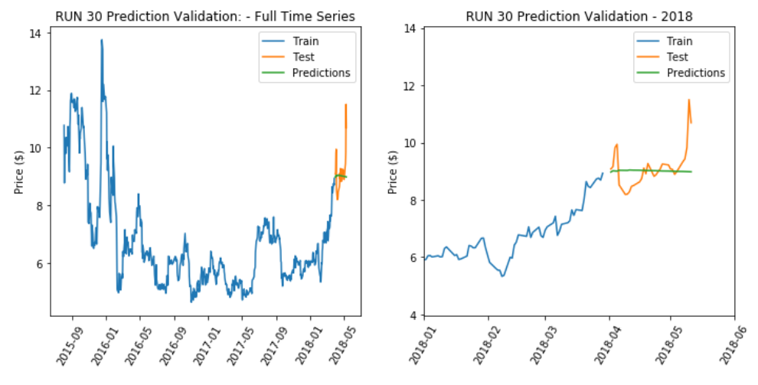
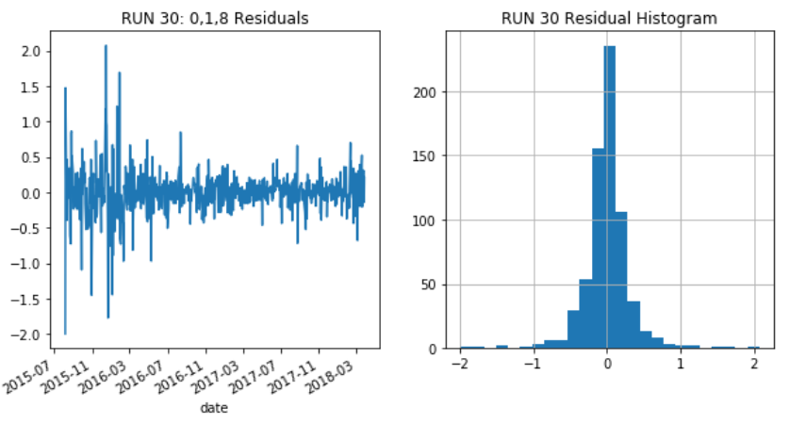
ARIMA - run
RUN (0, 1, 8)
No autoregression, one degree of differencing, 8 lags for moving avg.
MSE = 0.51
Stagnant forecast

Slide 14
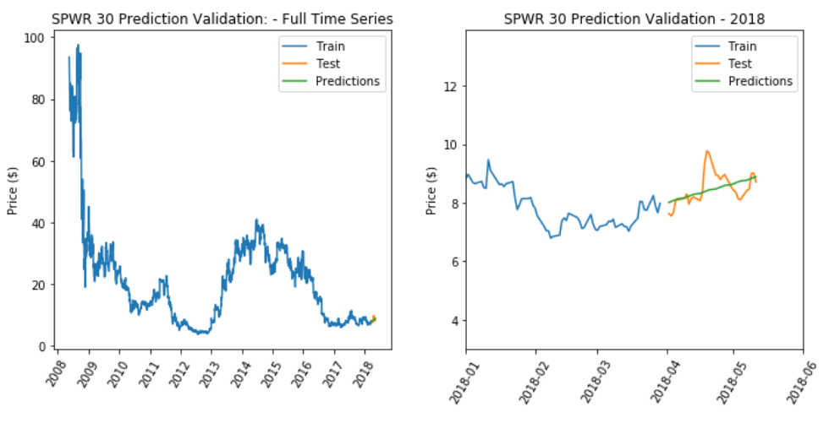
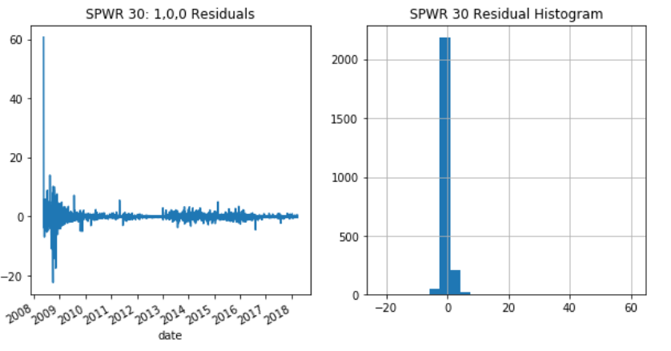
ARIMA - spwr
SPWR (1, 0, 8)
One autoregression lag, no differencing, 8 lags for moving avg.
MSE = 0.23 (lowest of all results)
Increasing forecast

Slide 15
prophet
Open-source forecasting package developed by Facebook Research
https://research.fb.com/prophet-forecasting-at-scale/
Additive Model:
Piecewise linear or logistic growth curve, automatically detects changes in trends through changepoints
Yearly seasonal component modeled by Fourier series
Weekly seasonal component using dummy variables
Can incorporate important holidays
User-friendly, straightforward and more intuitive, great visuals

Slide 16
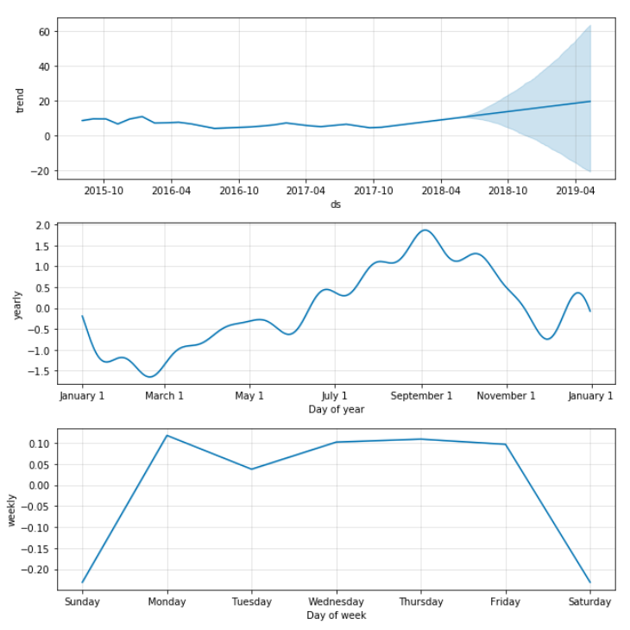
Prophet – run decomposition
Increasing overall trend
Lot of uncertainty
Yearly pattern likely noise
Weekly pattern reflects business days

Slide 17
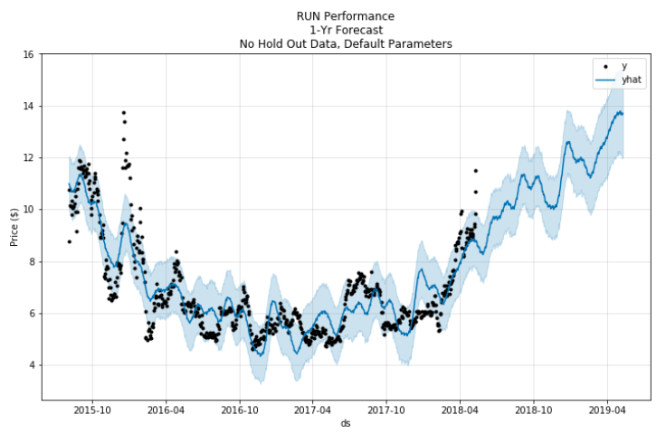
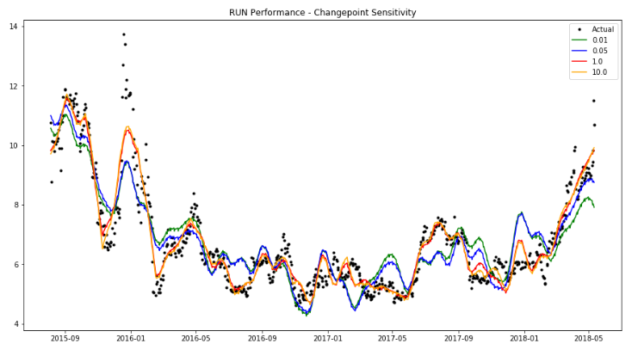
Prophet – run forecast
More realistic looking forecast, more dynamic
Positive outlook
Validation changepoint sensitivity = 1.0

Slide 18
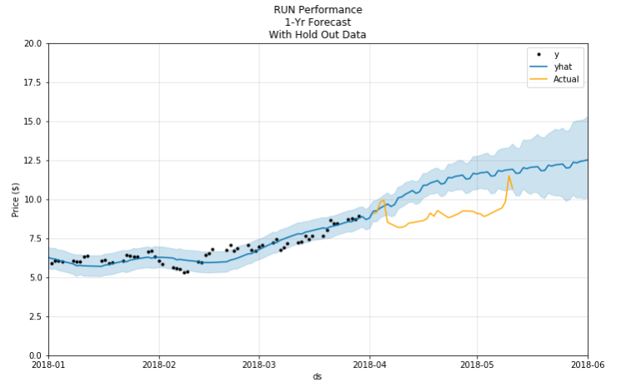
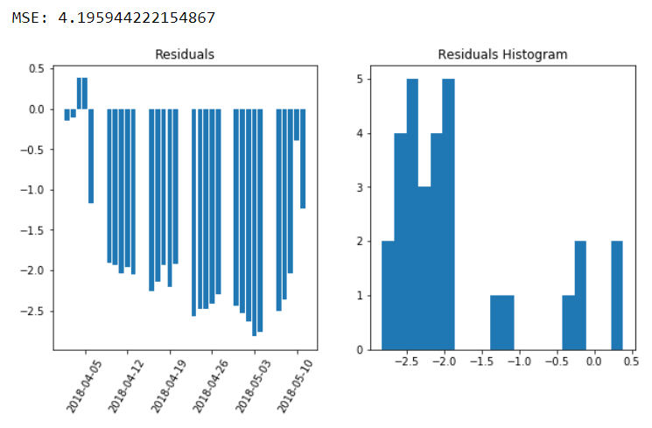
Prophet – run validation
Consistently overpredicting
Finding patterns that don’t appear to be true
Residuals look bad but model is built on linear and non-linear components

Slide 19
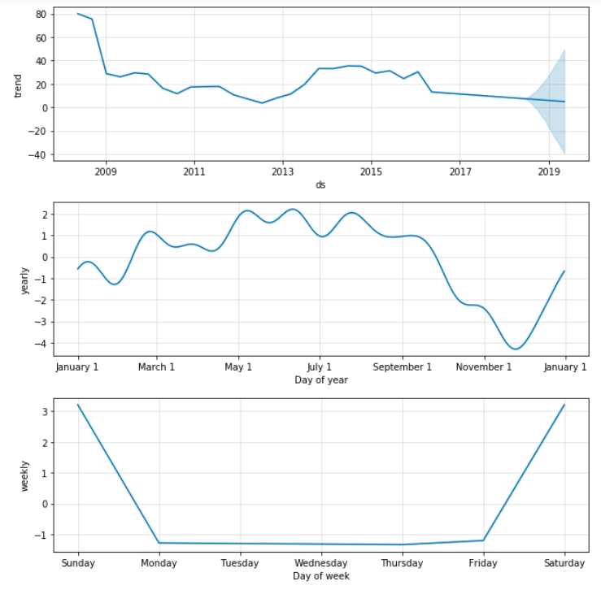
Prophet – spwr decomposition
Decreasing overall trend
Lot of uncertainty
Yearly pattern likely noise
Weekly pattern…?

Slide 20
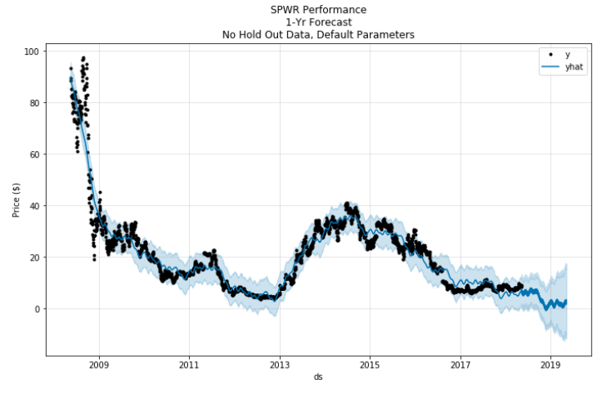
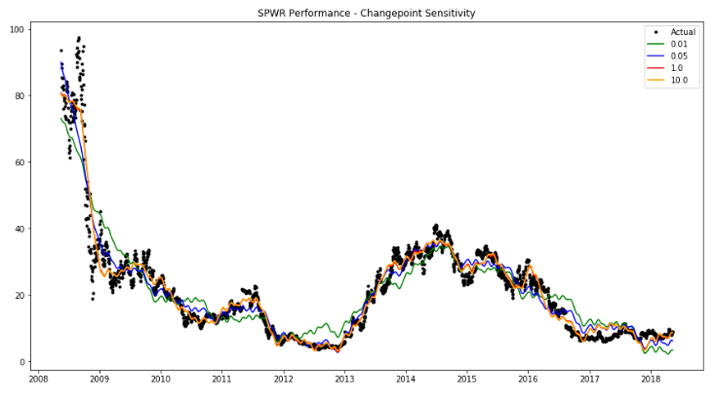
Prophet – spwr forecast
Negative outlook
Validation changepoint sensitivity = 1.0

Slide 21
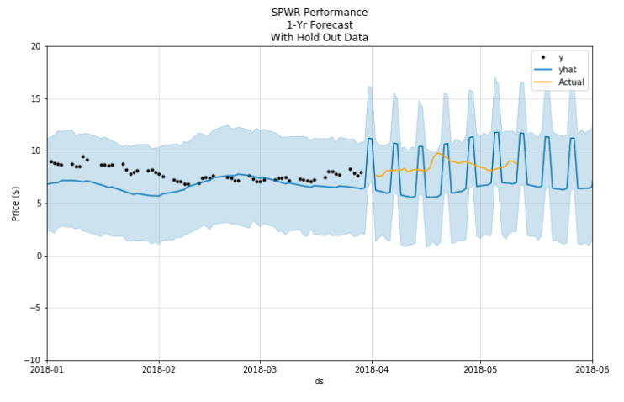
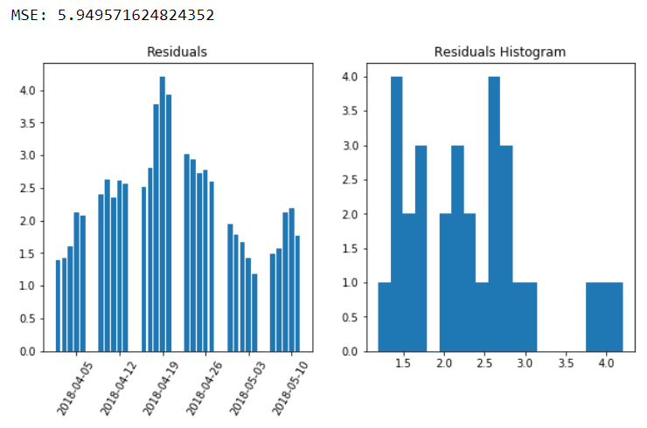
Prophet- SPWR validation
Underpredicting aside from high weekend trading
Finding patterns that don’t appear to be true
Residuals look bad but model is built on linear and non-linear components

Slide 22
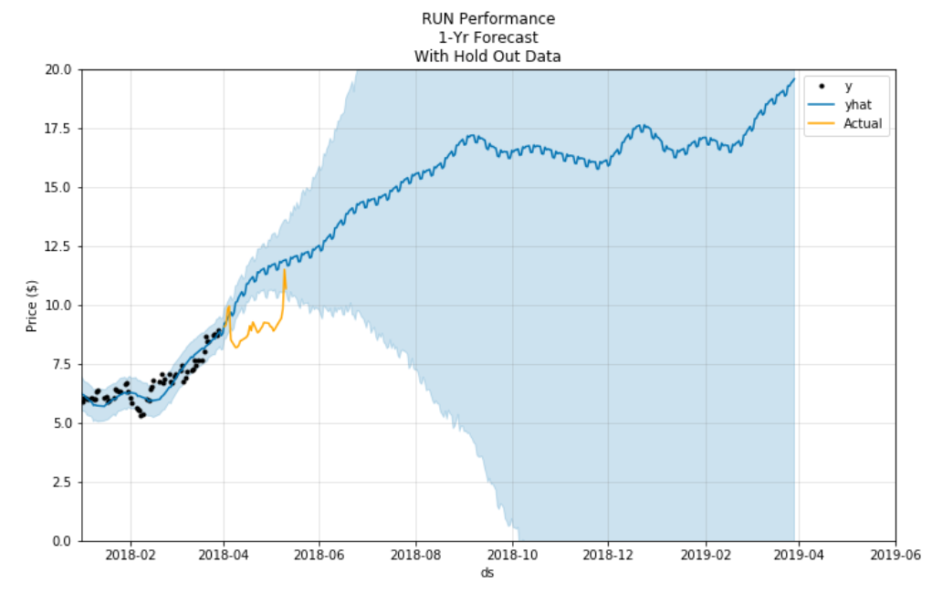
summary
Original questions:
Can we predict stock prices of companies pushing the solar industry forward with reasonable accuracy?
Depends (…define accuracy…risk tolerance)
Hard to forecast data with no structure
Can’t predict future stock prices based on past returns alone
Based on what we learn, does investing in solar hold promise?
Maybe? Consider other factors too…
Forecasts are very sensitive
Need for continuous data integration to make most accurate predictions
Shorter forecasting more realistic than long-term projections
Power is in the analysis and ability to visually compare performance, volatility
Cloud of uncertainty

Slide 23
demo
https://public.tableau.com/profile/missy.tracy#!/vizhome/SolarInvestingDashboard/Dashboard1
Exponential smoothing forecasting
Similar to moving average except weight of past observations decreases over time

